Slide 1
https://plot.ly/dash/getting-started
html.Div( [ SOME_HTML_OR_DASH_COMPONENT( id, content (data), style (a dictionary with the properties)) ], className = (name of the Bootstrap Class) )
Data
Layout
Title, color
Position

Slide 2
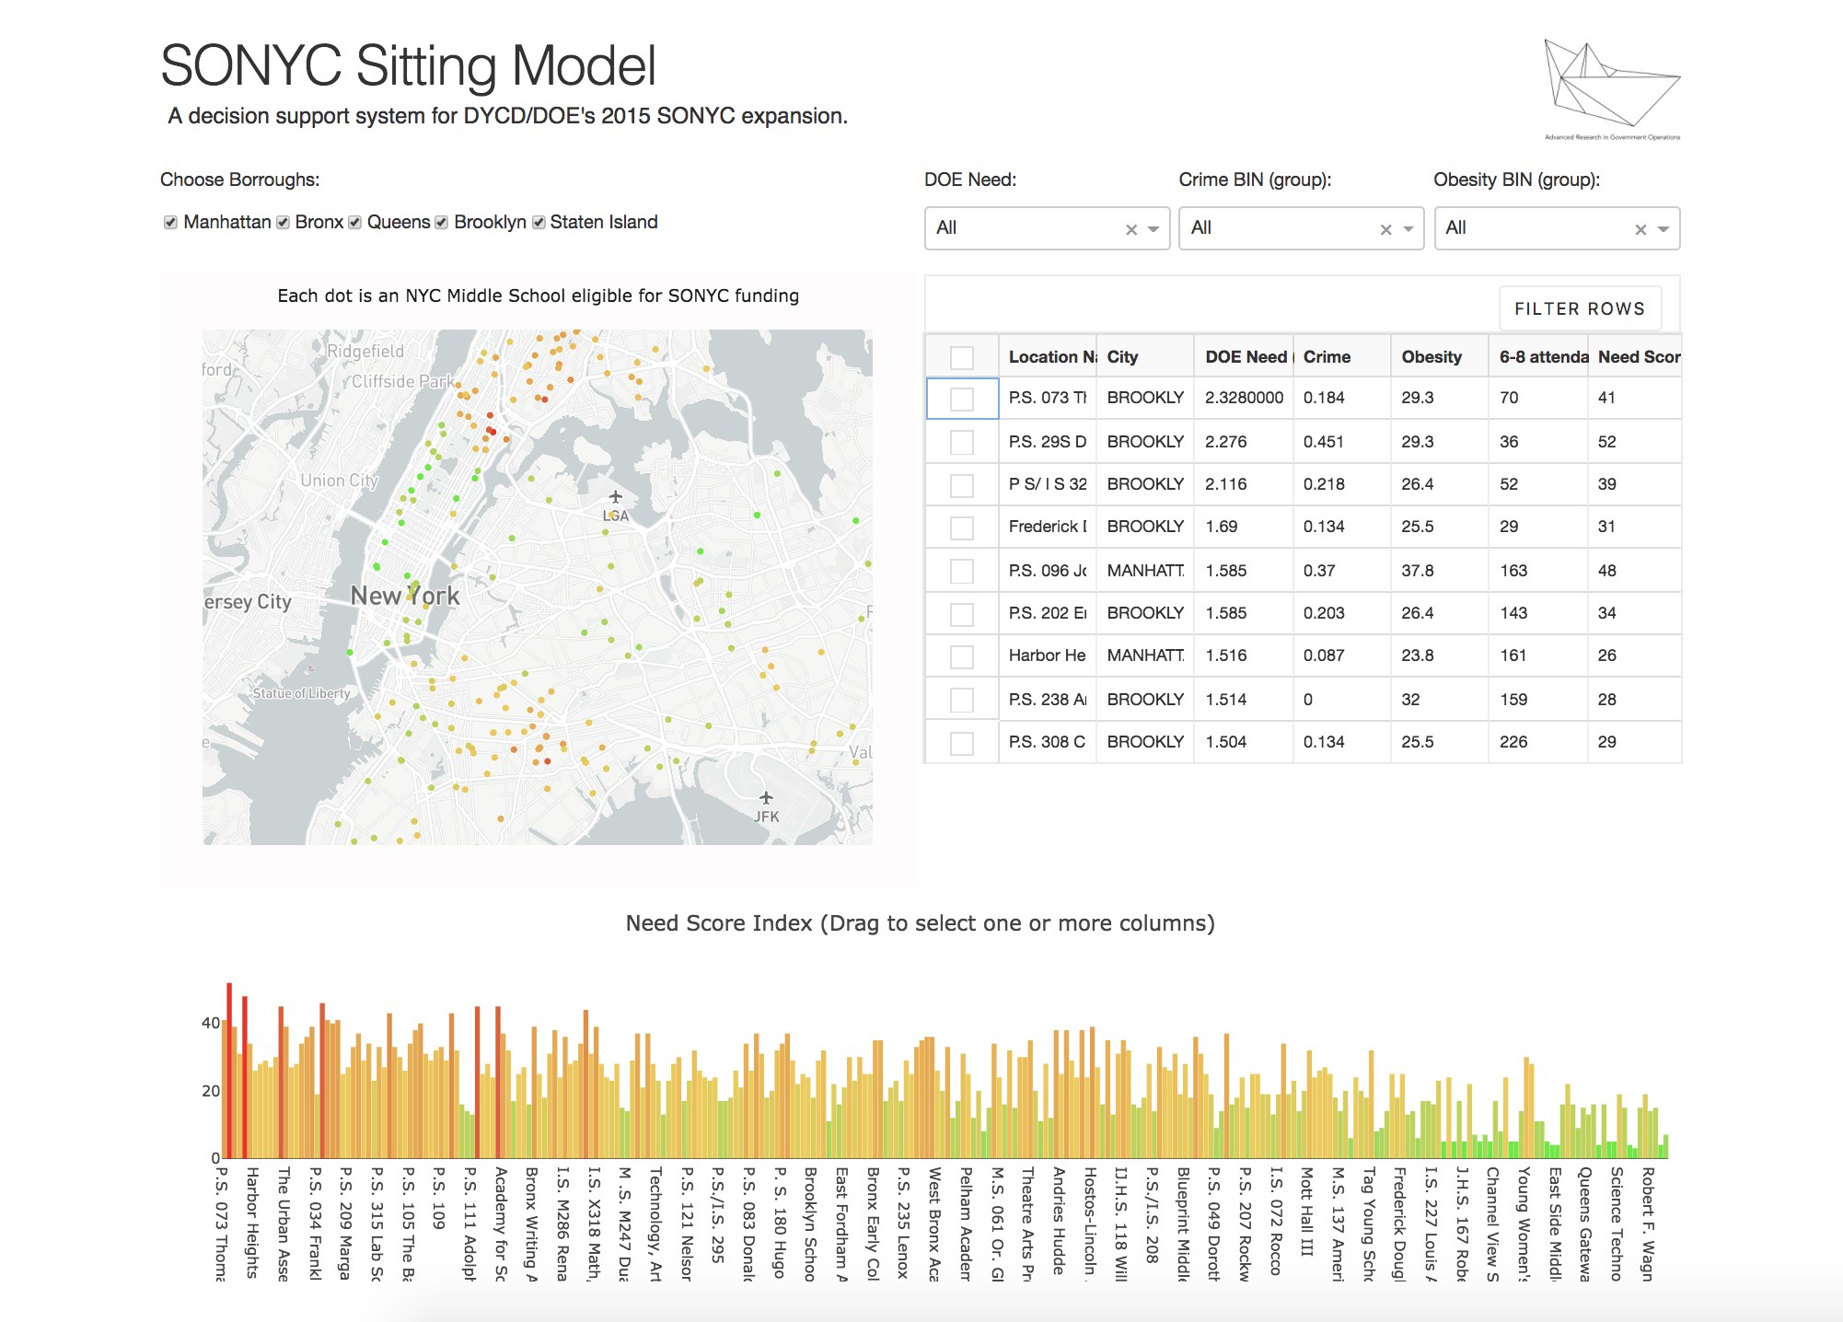
9 columns
3 columns
Row
Row
6 columns
2 columns
2 columns
2 columns
6 columns
6 columns
Row
12 columns

Slide 3
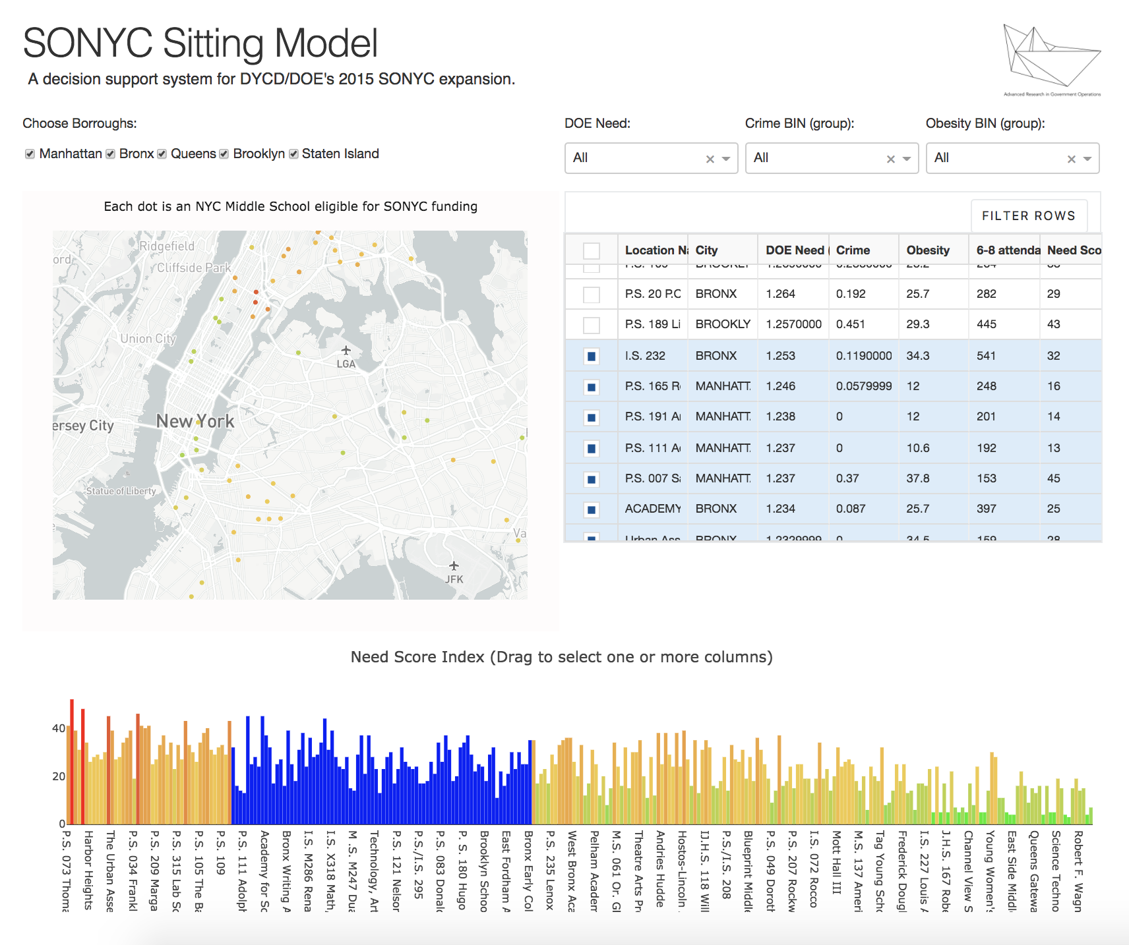
1 – Filters update table
3 - Update points in the map
2 - Select histogram or table row

